Slide 1

Python Fundamentals (week 2)
Louis Rey
UCSD Extension

Slide 2
Week 2 Objectives
Dictionaries
Loops and selection statements
Expressions and comprehensions
Generators and iterators
Conditional Code
List Comprehensions
Functions
Lambda Functions

Slide 3
Dictionaries

Slide 4
Dictionaries: A Matching Type
• Dictionaries store a mapping between a set of keys and a set of values.
• Keys can be any immutable type.
• Values can be any type
• A single dictionary can store values of different types
• You can define, modify, view, lookup, and delete the key-value pairs in
the dictionary.

Slide 5
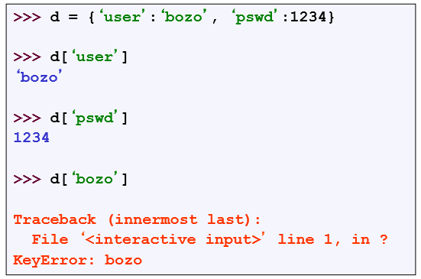
Creating and Accessing Dictionaries

Slide 6
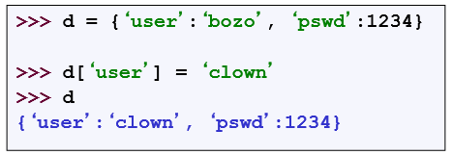
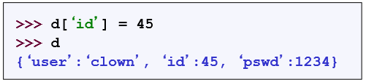
Updating Dictionaries
• Keys must be unique.
• Assigning to an existing key replaces its value.
• Dictionaries are unordered
• New entry might appear anywhere in the output.
• (Dictionaries work by hashing – Associative arrays)

Slide 7
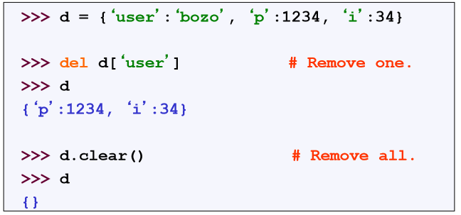
Removing Dictionaries Entries

Slide 8
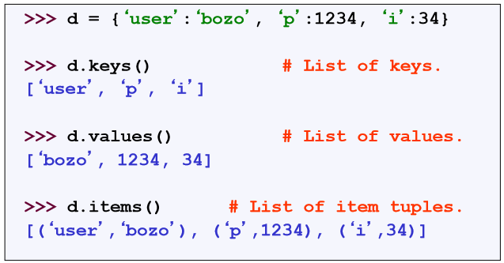
Useful Access Methods

Slide 9
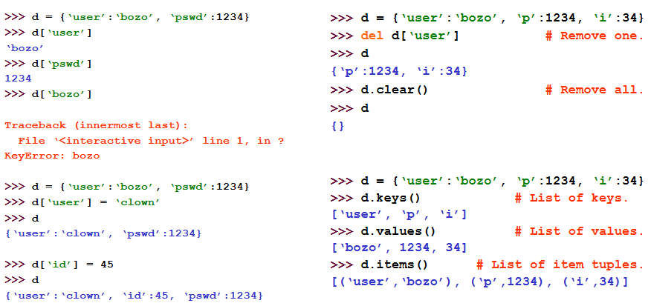
Using Dictionaries

Slide 10
Generators and Iterators

Slide 11
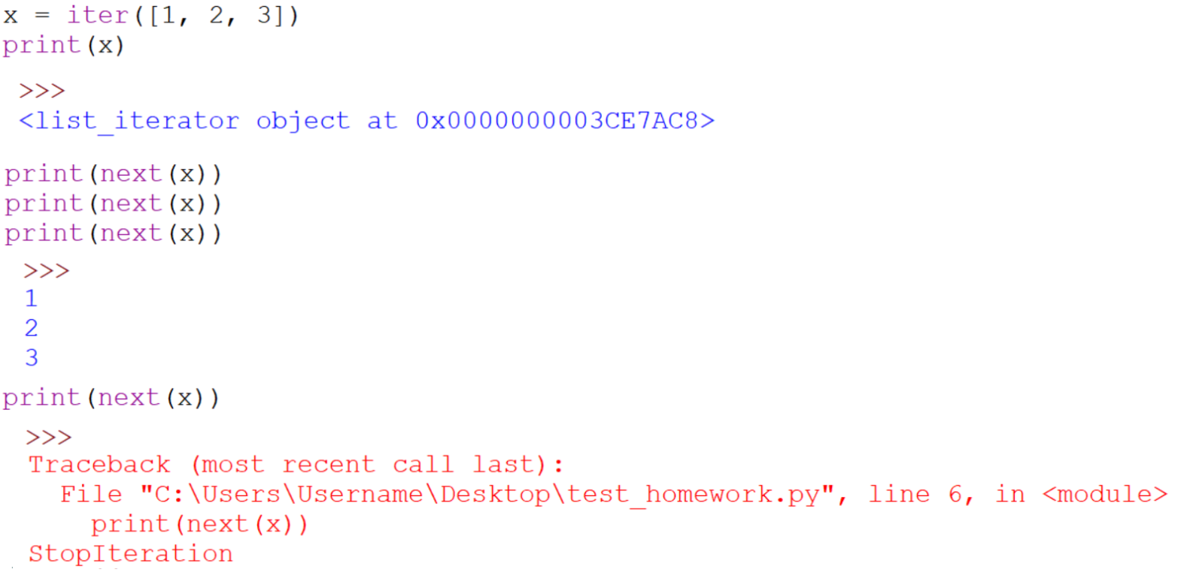
Python Iterators
• Objects which can be used with a for loop are called iterable objects
• Built-in function iter takes an iterable object and returns an iterator

Slide 12
Python Iterators
• Iterators can be implemented as classes
Uses __iter__ method to make an object iterable
Uses __next__ method to iterate through an object
Uses StopIteration( ) method when there are no more elements
• StopIteration( ) can be used to raise an exception
More examples will be shown in the class section

Slide 13
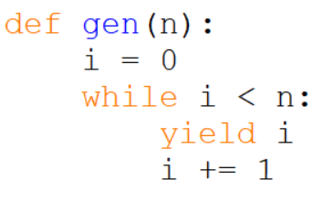
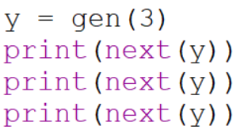

Python Generators
• Simplifies creation of iterators
Function that produces a sequence of results instead of a single value
yield statement allows function generate a new value
yield needs to be used within a function

Slide 14

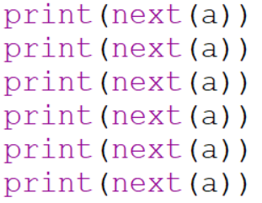

Generators Expressions
• Similar to list comprehension but does not create a list

Slide 15
Boolean Expressions

Slide 16
True and False
• True and False are constants in Python.
• Other values equivalent to True and False:
• False: zero, None, empty container or object
• True: non-zero numbers, non-empty objects
• Comparison operators: ==, !=, <, <=, etc.
• X and Y have same value: X == Y
• Compare with X is Y :
- X and Y are two variables that refer to the identical same object.
List comparators:
Li = [1, 2, ‘a’, 3, (‘hello’, 3.5)]
‘a’ in Li

Slide 17
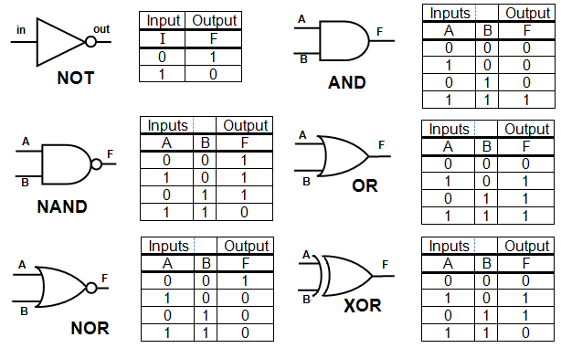
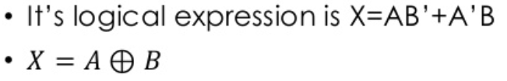
Logic Tables and Gates

Slide 18
Boolean Logic Expressions
• You can also combine Boolean expressions.
• true if a is true and b is true: a and b
• true if a is true or b is true: a or b
• true if a is false: not a
• Use parentheses as needed to disambiguate complex Boolean
expressions.

Slide 19
Special Properties of AND and OR
• Actually and and or don ’ t return True or False.
• They return the value of one of their sub-expressions (which may be a non-Boolean value).
• X and Y and Z
• If all are true, returns value of Z.
• Otherwise, returns value of first false sub-expression.
• X or Y or Z
• If all are false, returns value of Z.
• Otherwise, returns value of first true sub-expression.

Slide 20
Conditional Statements

Slide 21

If Statements: Basic structure
The keyword if starts the expression followed by a conditional comparison using any of the comparison operators: ==, !=, <, <=, etc.
The conditional statements can be used in conjunction with Boolean logic
A colon (:) after is used after the comparison expression
At least one statement must follow and it should be indented (if more than one statement is to be executed they will all need to have the same indentation)

Slide 22
Pseudocode
If the variable a less than 4 ?,
Print that the expression executed
If the variable a is equal to 7 and the variable b is greater or equal to 4,
Print that everything works

Slide 23
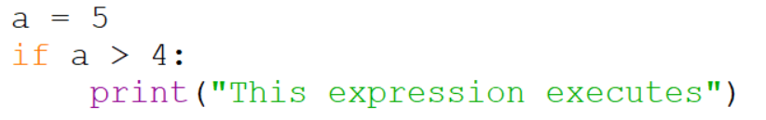


If Statements:

Slide 24
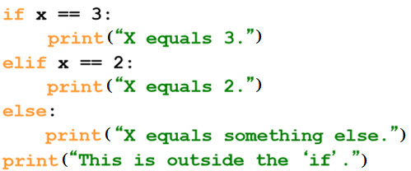
If Statements
Be careful! The keyword if is also used in the syntax of filtered list comprehensions.
Note:
• Use of indentation for blocks
• Colon (:) after Boolean expression

Slide 25
Control of Flow

Slide 26
Control of Flow
• There are several Python expressions that control the flow of a
program. All of them make use of Boolean conditional tests.
• if Statements
• while Loops
• assert Statements

Slide 27
If Statements
Be careful! The keyword if is also used in the syntax of filtered list comprehensions.
Note:
• Use of indentation for statement blocks
• Colon (:) after Boolean expression

Slide 28
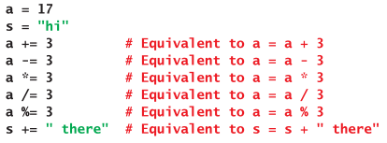
Augmented Assignments

Slide 29
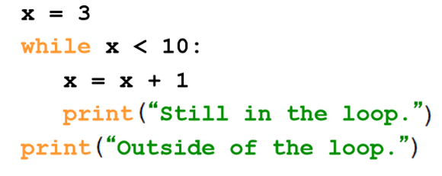
While Loops

Slide 30
For Loops

Slide 31
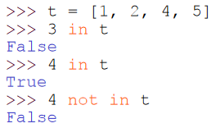
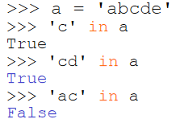
The ‘in’ Operator
• Boolean test whether a value is inside a container:
• For strings, tests for substrings
• Be careful: the in keyword is also used in the syntax of for loops and
list comprehensions.

Slide 32
For Loops/ List Comprehensions
• Python’s list comprehensions and split/join operations provide natural idioms that usually require a for-loop in other programming languages.
• As a result, Python code uses many fewer for-loops
• Nevertheless, it’s important to learn about for-loops.
• Caveat! The keywords for and in are also used in the syntax of list comprehensions, but this is a totally different construction.

Slide 33
For Loops
• A for-loop steps through each of the items in a list, tuple, string, or any other type of object which is “iterable”
for <item> in <collection>:
<statements>
• If <collection> is a list or a tuple, then the loop steps through each element of the sequence.
• If <collection> is a string, then the loop steps through each character of the string.
for someChar in “Hello World”:
print someChar

Slide 34
For Loops
for <item> in <collection>:
<statements>
• <item> can be more complex than a single variable name.
• When the elements of <collection> are themselves sequences, then <item> can match the structure of the elements.
• This multiple assignment can make it easier to access the individual
parts of each element.

Slide 35
For Loops and the Range() Function
• Since a variable often ranges over some sequence of numbers, the range() function returns a list of numbers from 0 up to but not including the number we pass to it.
• range(5) returns [0,1,2,3,4]
• So we could say:
for x in range(5):
print (x)
• (There are more complex forms of range() that provide richer functionality…)

Slide 36
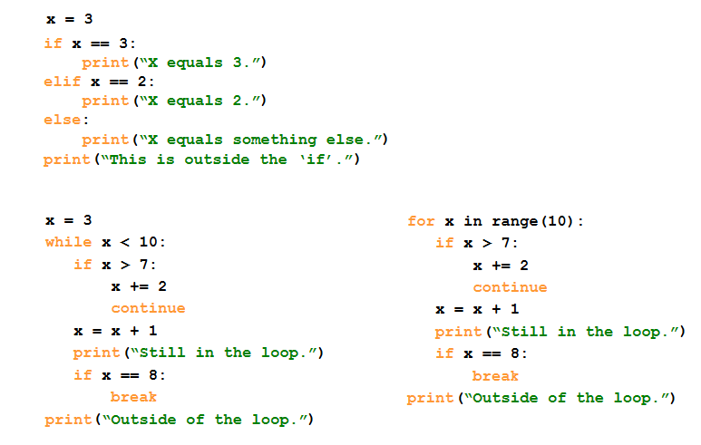
Examples

Slide 37
Generating Lists using “List Comprehensions”

Slide 38
List Comprehensions
• A powerful feature of the Python language.
• Generate a new list by applying a function to every member of an original list.
• Python programmers use list comprehensions extensively.
You’ll see many of them in real code.
• The syntax of a list comprehension is somewhat tricky.
• Syntax suggests that of a for-loop, an in operation, or an if statement
- all three of these keywords (‘for’, ‘in’, and ‘if’) are also used in the syntax of forms of list comprehensions.

Slide 39
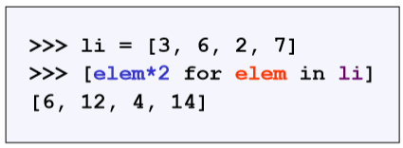
List Comprehensions
[ expression for name in list ]
• Where expression is some calculation or operation acting upon the variable name.
• For each member of the list, the list comprehension
1. sets name equal to that member,
2. calculates a new value using expression,
• It then collects these new values into a list which is the return value of the list comprehension.

Slide 40
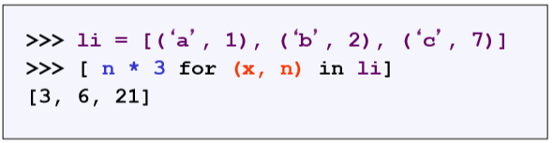
List Comprehensions
[ expression for name in list ]
• If list contains elements of different types, then expression must
operate correctly on the types of all of list members.
• If the elements of list are other containers, then the name can consist
of a container of names that match the type and “shape” of the list
members.

Slide 41
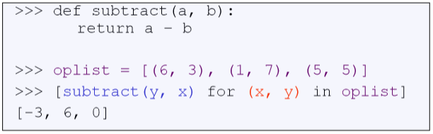
List Comprehensions
[ expression for name in list ]
• expression can also contain user-defined functions.

Slide 42
Filtered List Comprehensions
[expression for name in list if filter]
• Filter determines whether expression is performed on each member of the list.
• For each element of list, checks if it satisfies the filter condition.
• If it returns False for the filter condition, it is omitted from the list before the list comprehension is evaluated.

Slide 43
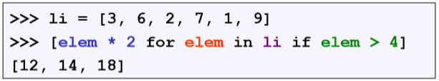
Filtered List Comprehensions
[expression for name in list if filter]
• Only 6, 7, and 9 satisfy the filter condition.
• So, only 12, 14, and 18 are produced.

Slide 44
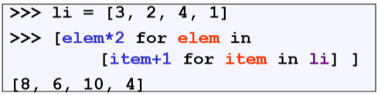
Nested List Comprehensions
• Since list comprehensions take a list as input and produce a list as
output, they are easily nested:
• The inner comprehension produces: [4, 3, 5, 2].
• So, the outer one produces: [8, 6, 10, 4].

Slide 45
Memory Structure

Slide 46
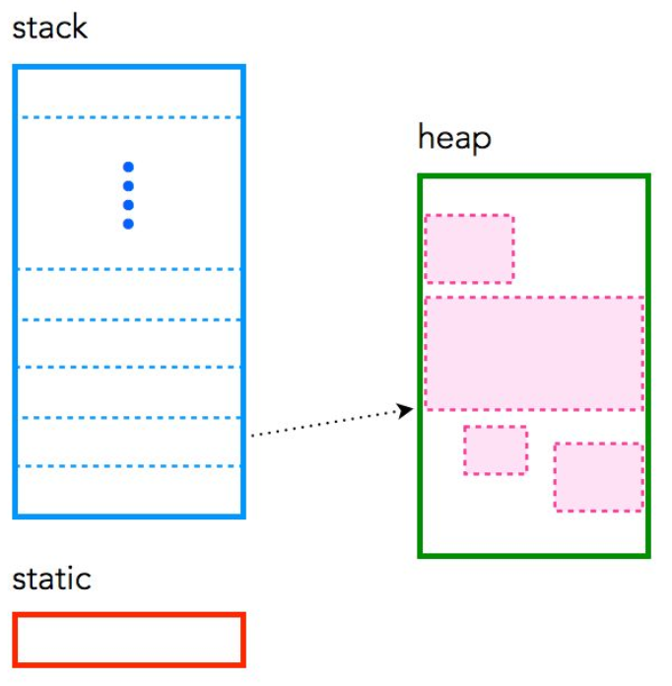
Memory Structure
static: global variable storage, permanent for the entire run of the program
stack: local variable storage (automatic, continuous memory)
heap: dynamic storage (large pool of memory, not allocated in contiguous order).

Slide 47
Functions

Slide 48
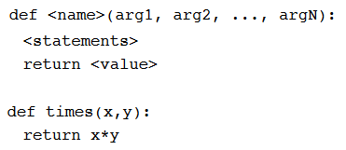
Functions
• def creates a function and assigns it a name
• return sends a result back to the caller
• Arguments are passed by assignment
• Arguments and return types are not declared

Slide 49
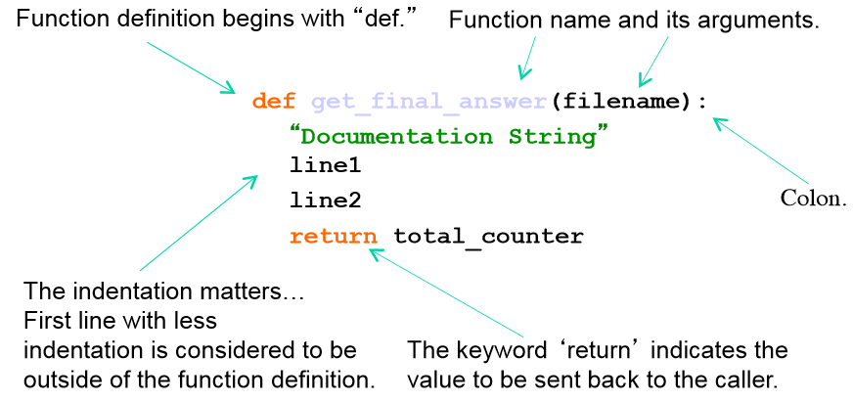
Defining Functions

Slide 50
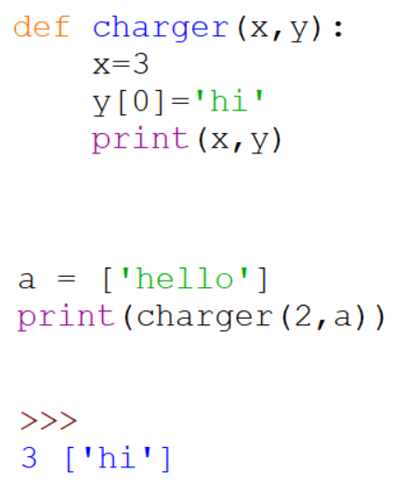
Passing Arguments to Functions
• Arguments are passed by assignment
• Passed arguments are assigned to local names
• Assignment to argument names don't affect the caller
• Changing a mutable argument may affect the caller

Slide 51
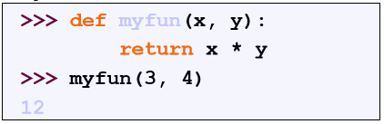
Calling a Functions
• The syntax for a function call is:
• Parameters in Python are “Call by Assignment.”
• Sometimes acts like “call by reference” and sometimes like
“call by value” in C++.
- Mutable datatypes: Call by reference.
- Immutable datatypes: Call by value.

Slide 52
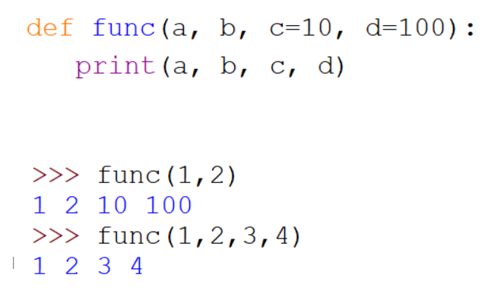
Optional Arguments
• Can define defaults for arguments that need not be passed

Slide 53
Gotchas
• All functions in Python have a return value
• even if no return line inside the code.
• Functions without a return returns the special value None.
• There is no function overloading in Python.
• Two different functions can’t have the same name,
even if they have different arguments.
• Functions can be used as any other data type.
They can be:
• Arguments to function
• Return values of functions
• Assigned to variables
• Parts of tuples, lists, etc

Slide 54
Program Scope

Slide 55
Local and Global Scope
• Local Scope
• Visible only to a function or method that contains it
• Visible only to a Class and it’s instances
• Global Scope
• Visible to all areas of a code
• Variables declared outside of a function or class
• global keyword needed to make data or variables visible within a function or class
• nonlocal keyword used when nesting one function inside another function

Slide 56
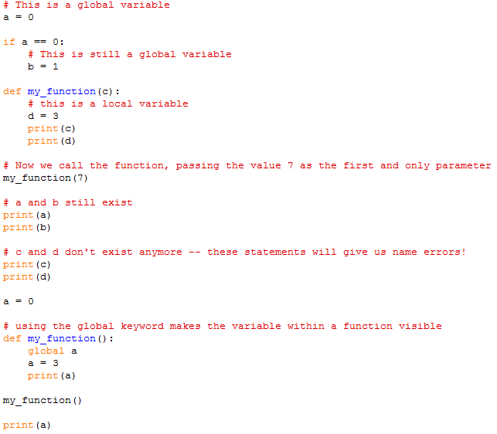
Local and Global Scope

Slide 57
Recursive Functions

Slide 58
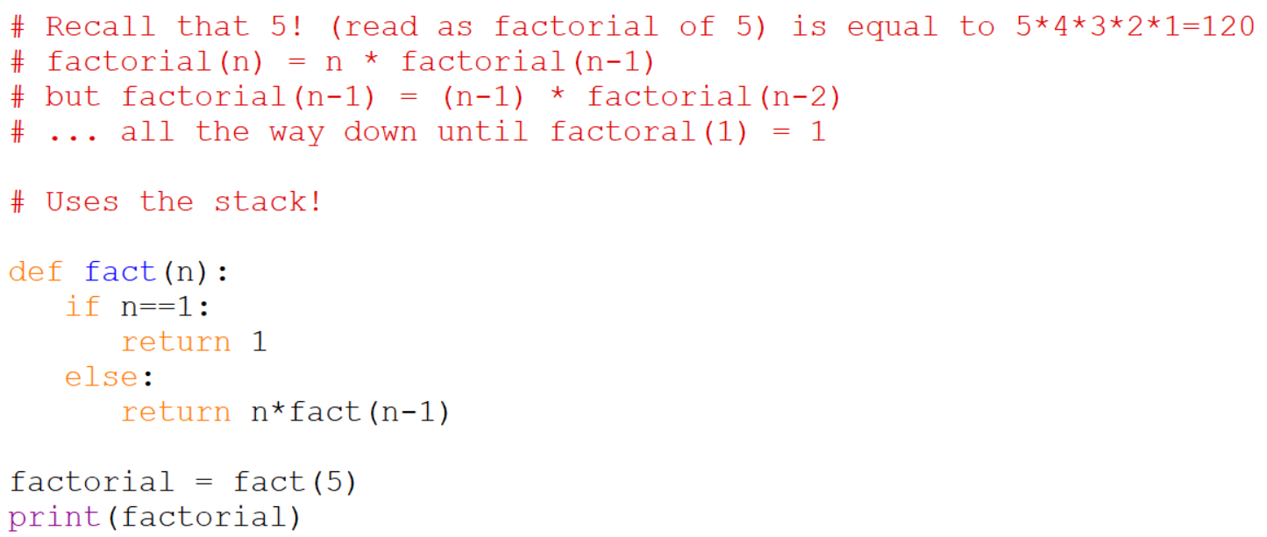
Recursive Functions
This only works for positive numbers, not negative one
Cannot complete the answer until the number reaches 1
Multiple variable called n are created, not just one n
Needs to work out what fact(5) is, but needs fact(4) … until fact(1) is reached

Slide 59
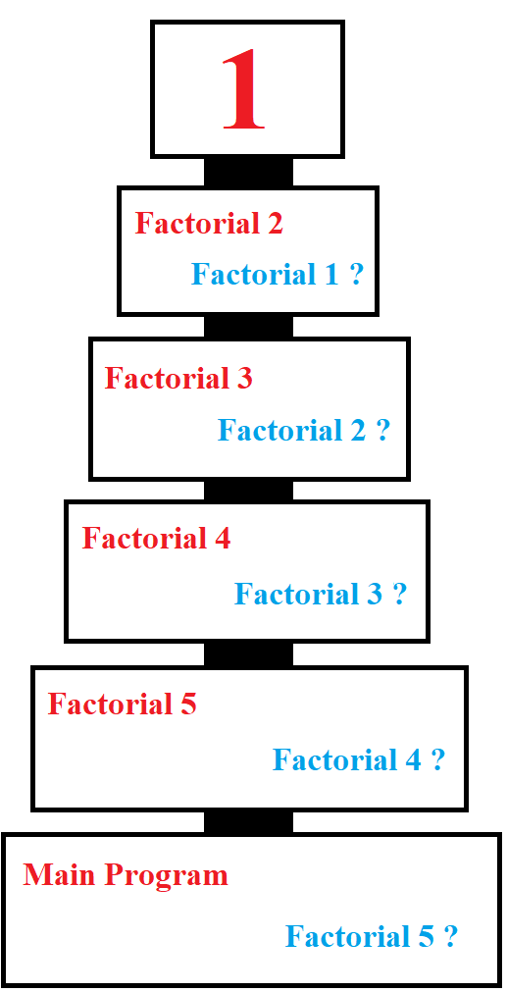
Recursive Functions
Composed of a series of pending multiplies
➔ Factorial 1 = 1
➔ 2 * Factorial 1 = 2 * 1 = 2
➔ 3 * Factorial 2 = 3 * 2 = 6
➔ 4 * Factorial 3 = 4 * 6 = 24
➔ 5 * Factorial 4 = 5 * 24 = 120
➔ Factorial 5 = 120

Slide 60
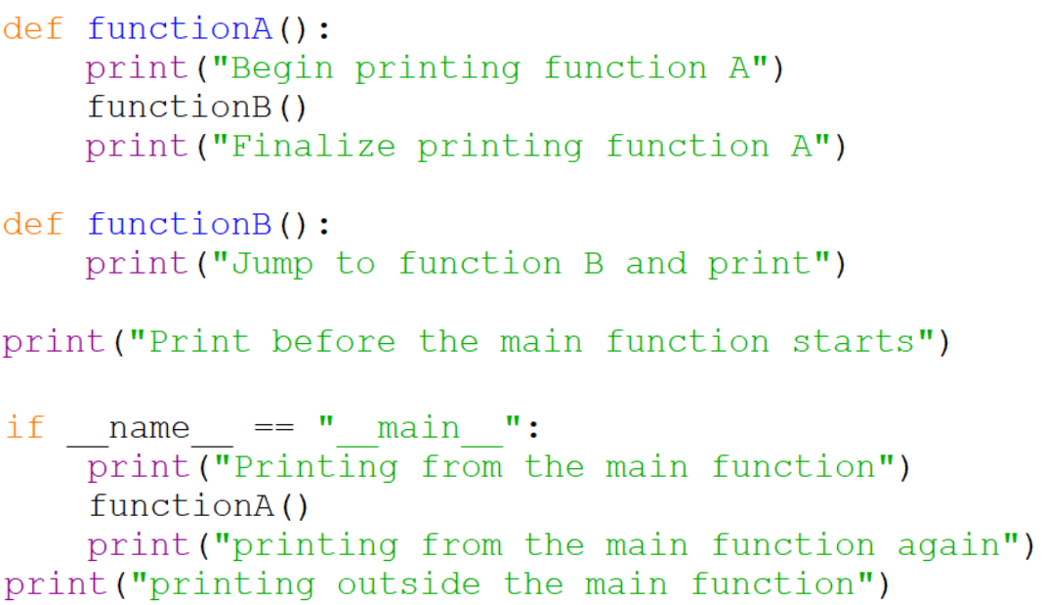
The Main Function

Slide 61
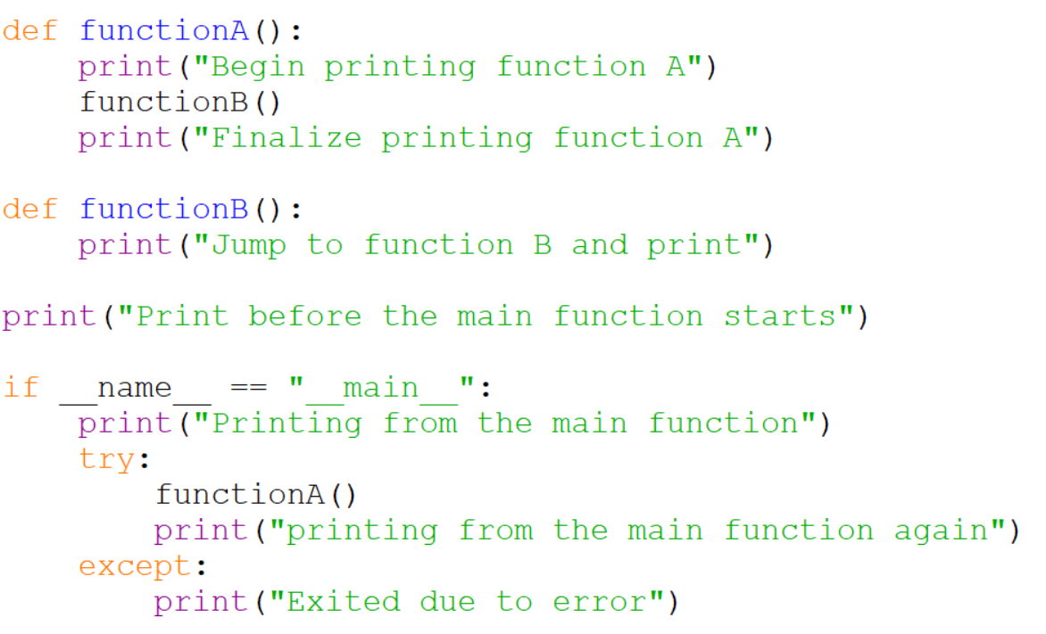
Exception Handling

Slide 62
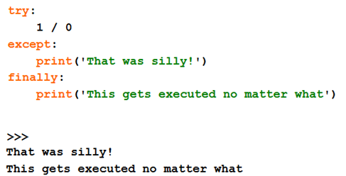
Exception Handling

Slide 63
More Options in Python

Slide 64
Break and Continue
• You can use the keyword break inside a loop to leave the while loop
entirely.
• You can use the keyword continue inside a loop to stop processing
the current iteration of the loop and to immediately go on to the
next one.

Slide 65
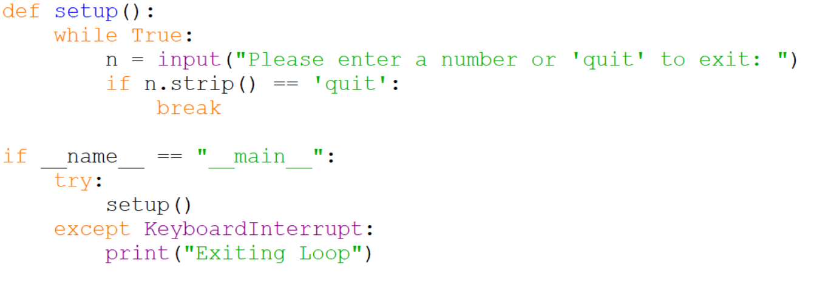
Break in an Infinite While Loop

Slide 66
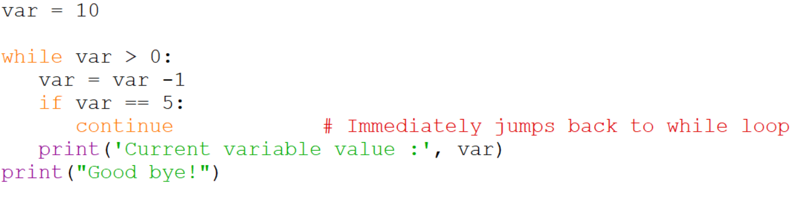
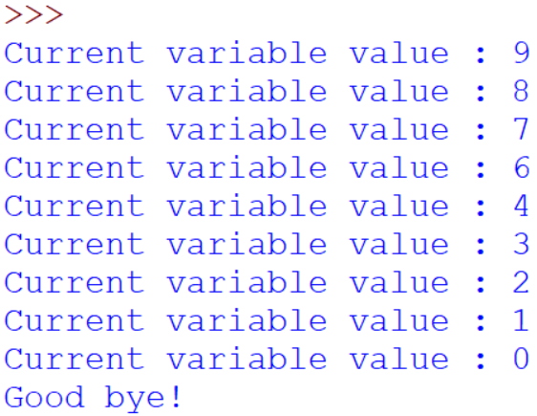
Continue in a While Loop

Slide 67
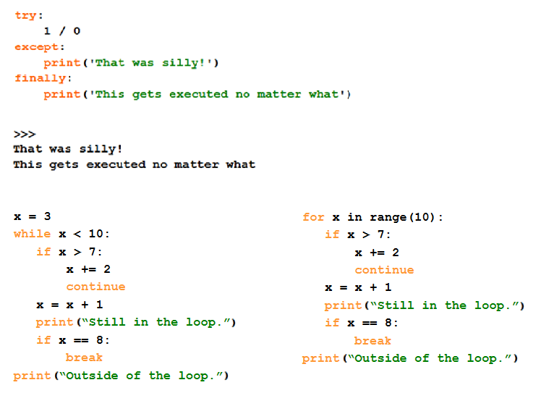
Break, Continue and Exceptions…

Slide 68
Alternative Function Statement

Slide 69

Lambda Notation
• Functions can be defined without giving them names (anonymous).
• This is most useful when passing a short function as an argument to
another function.
• The first argument to applier() is an unnamed function that takes one
input and returns the input multiplied by four.
• Note: only single-expression functions can be defined using this lambda
notation.

Slide 70
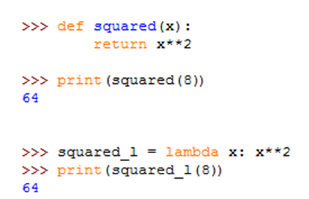
Lambda Functions
The lambda notation does not include a "return" statement -- it always contains an expression which is returned.

Slide 71
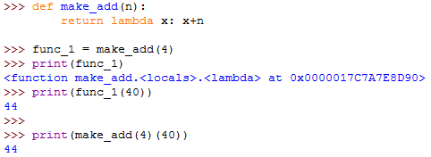
Lambda Functions
This example creates an anonymous function on the fly and returns it

Slide 72
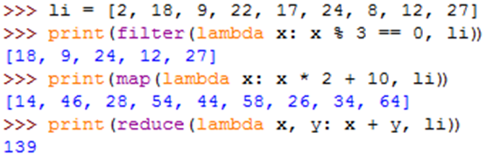
Lambda Functions
Example of an anonymous function in conjunction with standard functions: filter(), map() and reduce()
filter() calls our lambda function for each element of the list, and returns a new list that contains only those elements for which the function returned "True".
map() is used to convert to a new list using values from the lambda function.
The reduce() function calls the lambda function n-1 times if the list contains n elements.

Slide 73
Resources
Matt Huenerfauth (Penn State)
Guido van Rossum (Google)
Richard P. Muller (Caltech)
Bill Boyd (Weslayan University)
Smithsonian Telescope Data Center
Programming Python, Mark Lutz
Fundamentals of Python, Kenneth Lambert

